Slide 1
Discord application project:

Slide 2
INTRODICATION
In the introduction, we talked about the Discord Apps and that it was launched in 2015 and the inventor of the Discord Application . We also talked about the problem of the Discord (how to communicate with friends around the world while playing games online.)program and the solution to this problem as well, the work plan and the use of the most appropriate model for applying Discord, which is agile.

Slide 3
FUNCTIONAL REQUIREMENTS
WE COLLECTED THE FUNCTIONAL REQUIREMENTS FOR THE APPLICATION AS FOLLOWS:
user sign up
Profile setting and personalisation
Push notifications
Send friend request/follow request
In-app chat /calling
Content sharing
Video/audio streaming
Create threads

Slide 4

NON-FUNCTIONAL REQUIREMENTS
Security
Response
performance
Ease of use

Slide 5
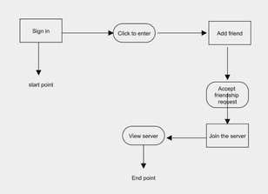
ACTIVITY DIAGRAM

Slide 6
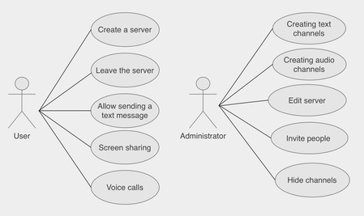
USE CASE MODLING
ACTORS

Slide 7


USE CASES &ITS RELATED USE CASES

Slide 8
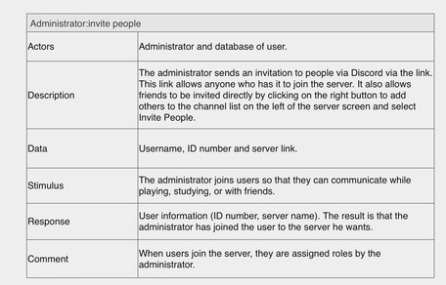
TABLE

Slide 9
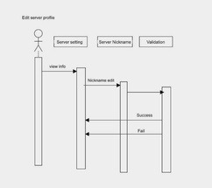
SEQUENCE DIAGRAMS

Slide 10
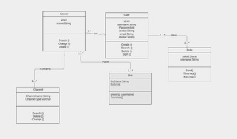
CLASS DIAGRAM

Slide 11
THE END
Names of the project students:
Nourah Salim Mufleh Al-Dosar
Mashael Hadi Al-Ammar
Reem Nashi Al-Ammar
Sarah Hammad Al-Hammad

